Slide 1
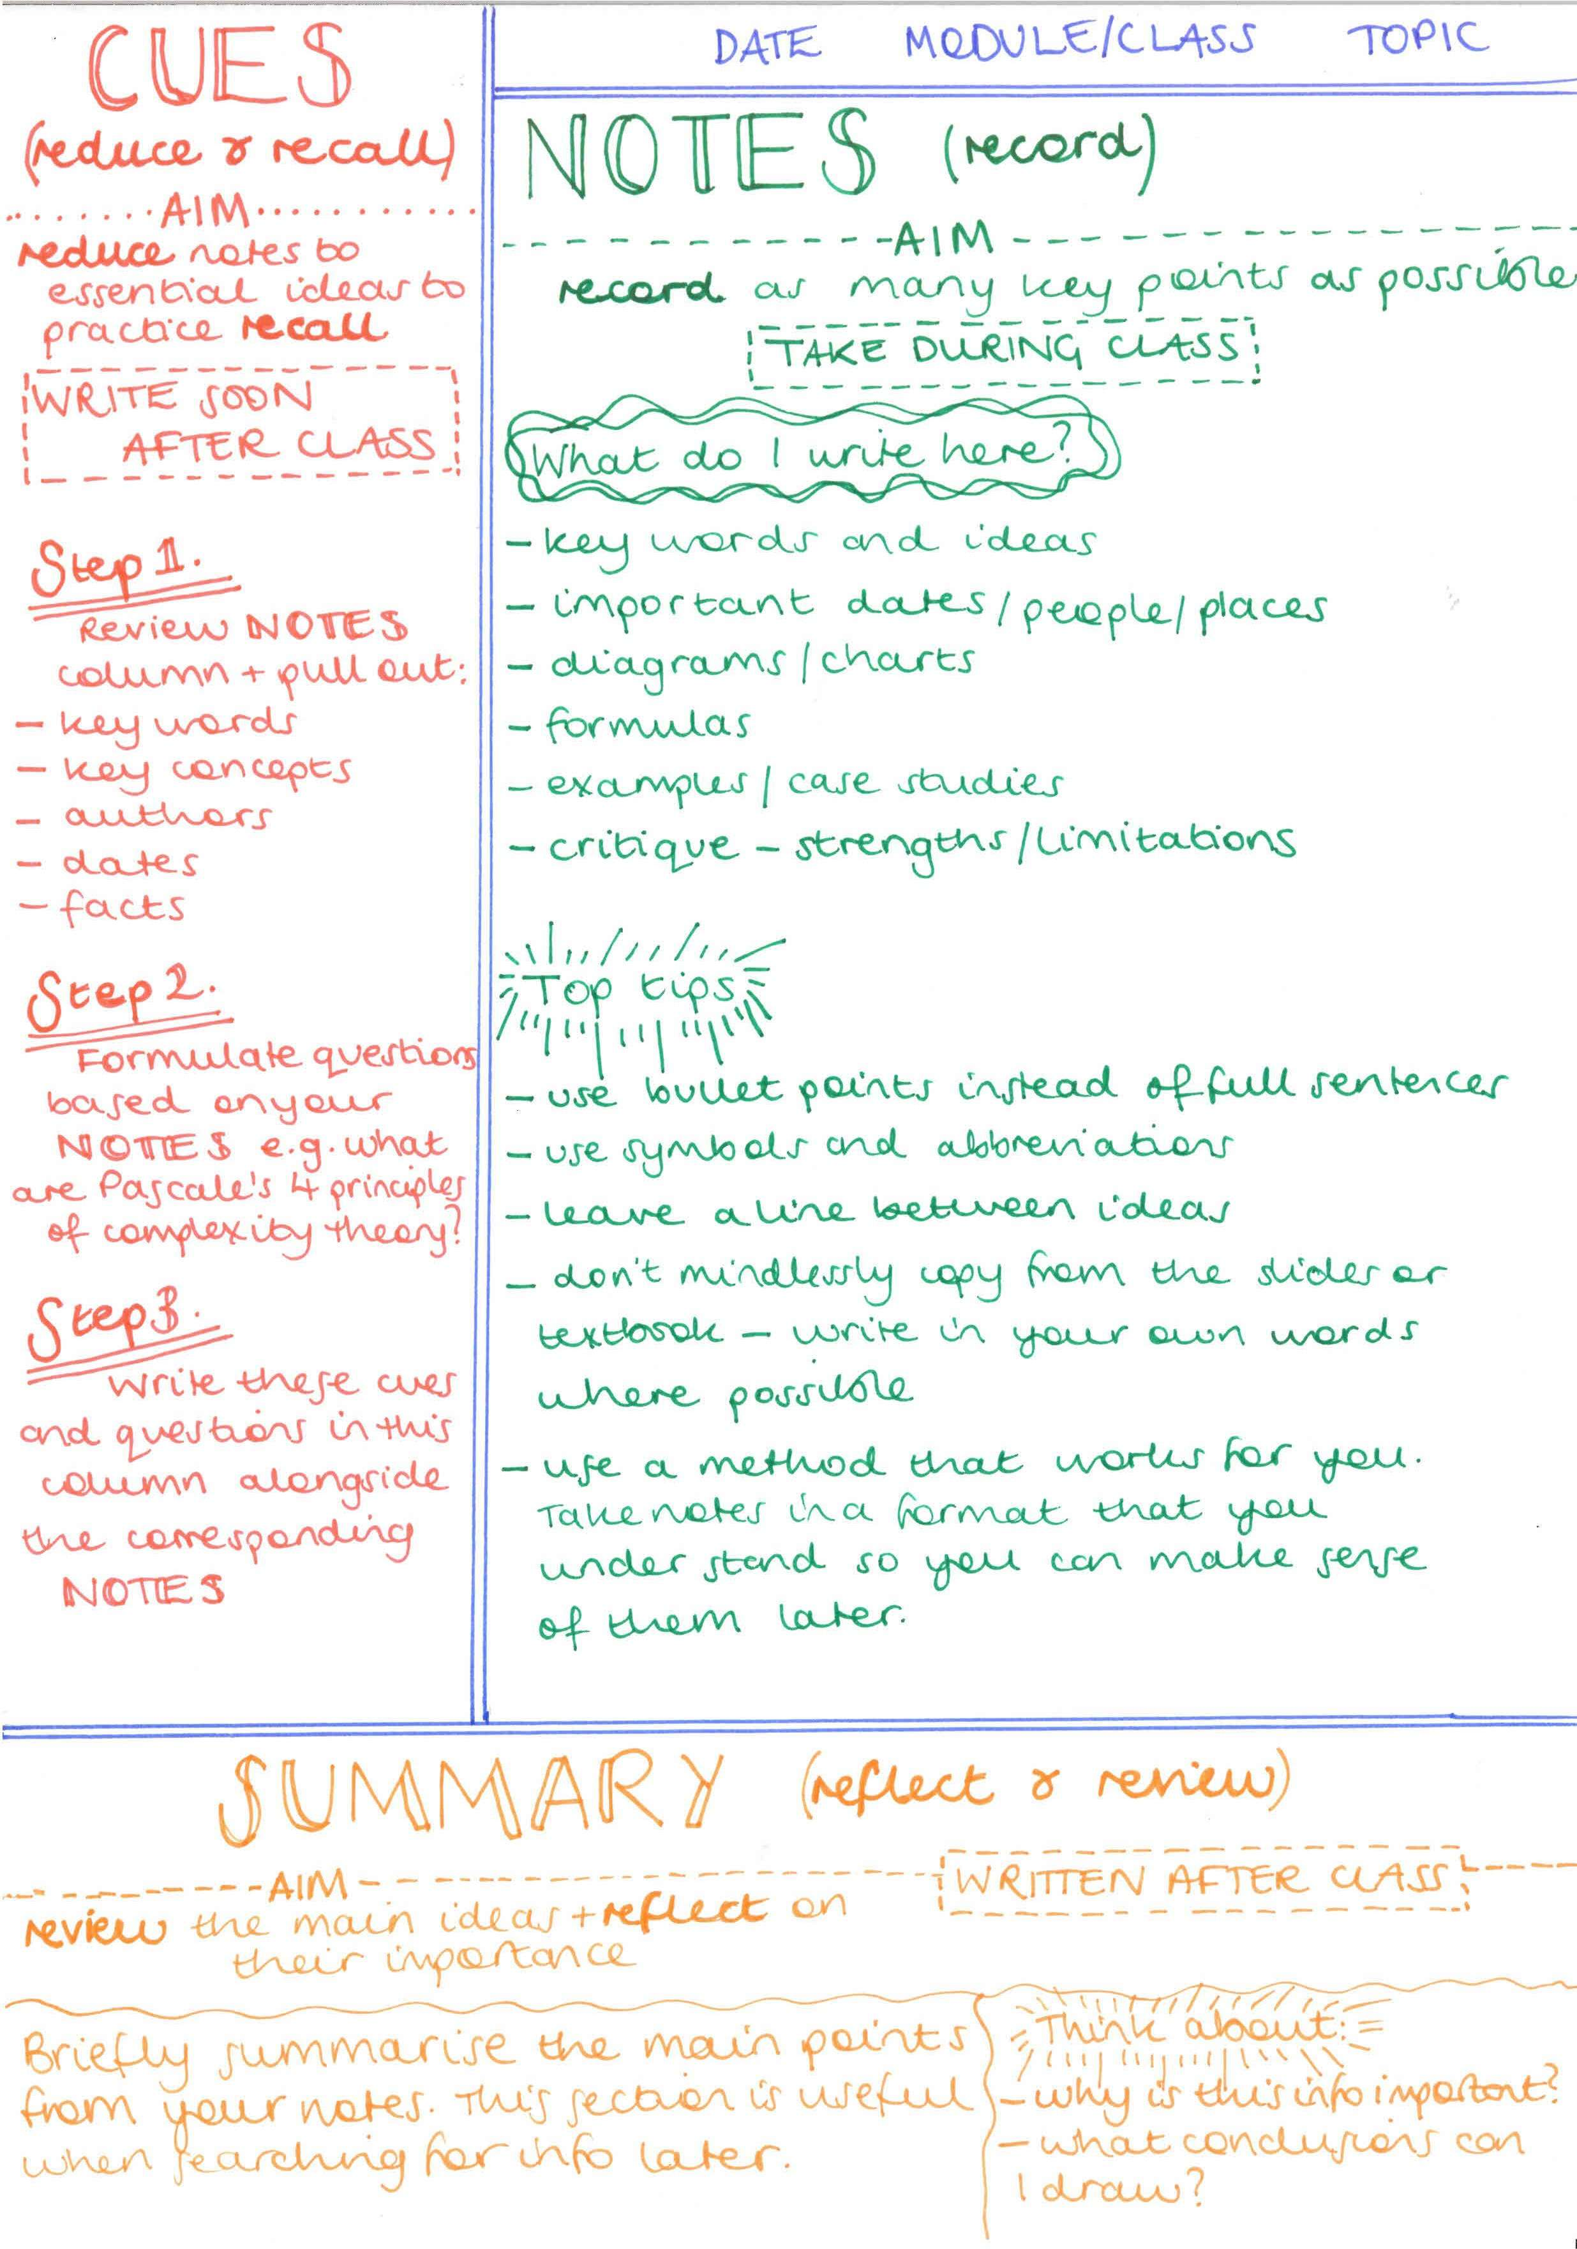
1. Get notes in order
If you have notes, get them into an order to help utilise what you already have. If you haven’t made any extra notes, use your exercise books and materials from lessons.
Find out what your gaps are using checklists given to you in lesson. If you don’t have a checklist – look on your emails/arbor/teams for revision lists that have been posted. You can find your gaps from these lists by reflecting on what you feel confident with or what you don’t feel confident with.
Cornell note taking (pictured) is a great way of organising classwork and your notes. Look at the how to guide pictured following these steps. Soon you will be an expert!
Title of lesson/topic.
Complete notes/diagrams with labels in notes section.
Come up with a key word or phrase to remember each point in the “cue” section.
Write 3 main points from the Cues in the summary box, or make up questions from the cues to help you remember the notes.

Slide 2
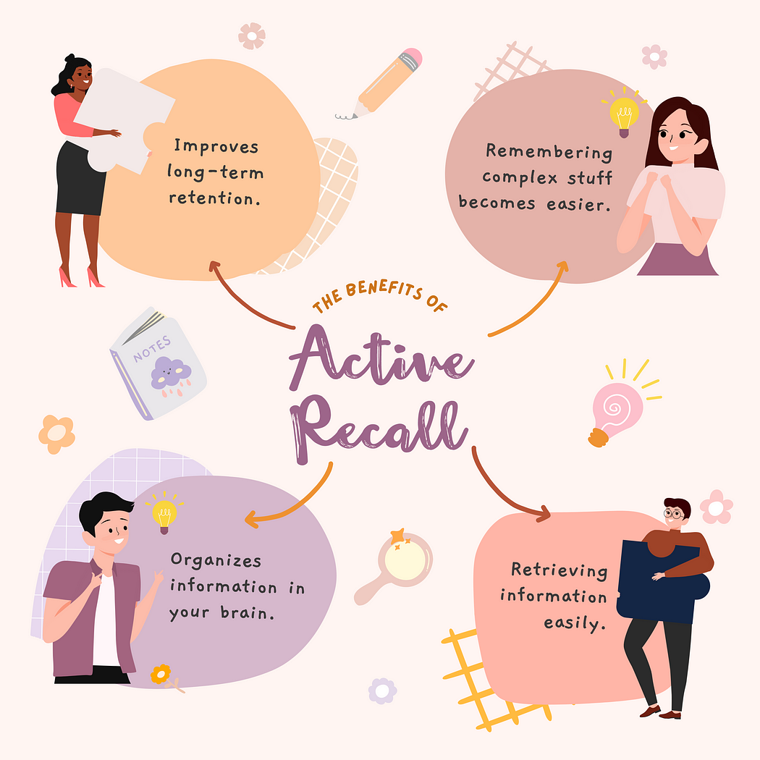
2. Condensing notes
You can do this in several small, effective ways.
Transform pages of notes to 10 key points. Then summarise to 3 main points, then 1 key word. Some students use a flip and fold technique with this where they perform each task on each folded side. The main sheet would have all the notes, then fold in half. Then on half the page summarise the main page notes. Fold in half again, and on the blank space, summarise the summary and keep folding until you get to one keyword or phrase.
You can cover up notes and try to memorise what you have written which is simple and effective, with no cost at all. Another form of note condensing is active recall:
Reading your notes.
Cover them up. Re-write as much as you can from memory.
Compare your notes to the written notes.
Add missing content in a different colour.
Repeat 2-3 times.

Slide 3
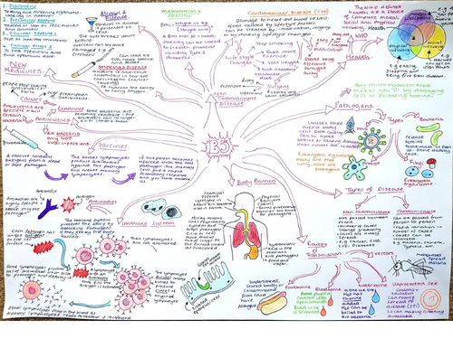
3. Mind maps
Mind maps are a visual way to organise information.
Usually, a mind map is for one topic. E.g. Electrolysis.
The most effective mind maps are short/bullet points/phrases alongside labelled diagrams and images to help you remember the information you are displaying.
They comprise of key ideas and links to other topic areas.
To use effectively:
Use notes you have made or a revision guide to make your mind map.
Pin them up somewhere you will look (a bedroom wall, the fridge, back of a door) so you see them regularly and can reference them for other revision strategies.
Re-draw the mind map from memory, as much as you can in 5 minutes. Refer to the original afterward and then add the missing info with a different coloured pen.
Bonus idea!
Create a set of 10 questions from your mind map with the best answers on flashcards. Then try to recall the answers to the question on those cards or look at the answers and think what the question could be.

Slide 4
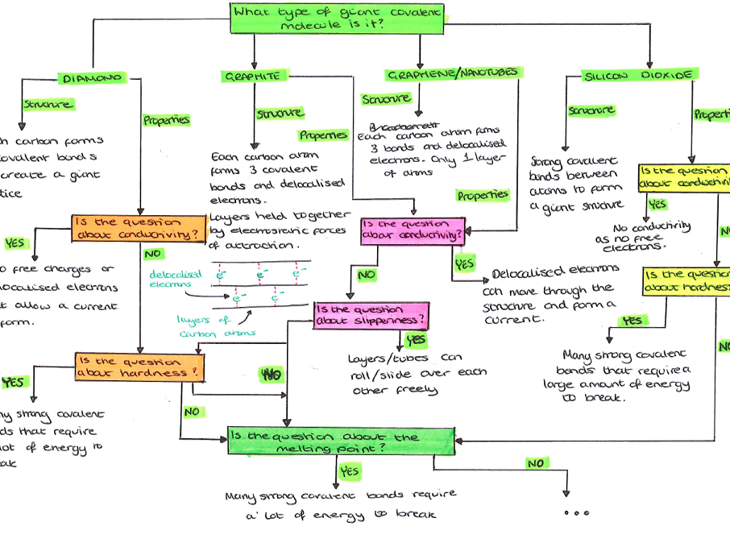
4. Flow charts
They are a diagram that show chronology of events or a process usually, but could also show the concepts which you build upon. For instance, the top of a flow chart could be Ions, then ionic bonding, ionic properties then at the bottom electrolysis.
They work for a lot of subjects; namely, business studies (supply chains), history (a timeline of events that led to the great depression), science (the steps of a practical experiment), geography (the stages of erosion) and maths (the process of working out a percentage).

Slide 5
5. Flashcards
So many students make the prettiest flashcards, but then never look at them again.
This is a waste of time!
Look at how you can be more effective with your revision below…
The best flashcards have a question or prompt on one side (like a diagram or key word for instance) and then the answer on the back.
They are a great way of testing yourself and others, filling in gaps and assessing where your areas of weakness are.
Flashcards are good for:
Important dates
Language vocabulary
Keywords and definitions
Formulae and equations
Labelled diagrams
They aren’t great for learning things like process and more complex information which can’t be easily split up. Other ideas in this slideshow will help you with those more complex pieces of information.
Use can use flashcards that are already done and available online, or you can make your own.
How to use effectively…
Read the flashcard, turn it over and say the answer out loud.
Group the flashcards based on your confidence. Have a pile which you know well, then a pile you sometimes get right but not always and another pile which you always forget. Focus on the ones you are least confident with. This will make everything else seem easier to do and in turn, build up your confidence.
Finally, ask someone else to test you! They don’t have to know the content because the answers are there for them to read to you and then you repeat.

Slide 6
5. Flashcards
So many students make the prettiest flashcards, but then never look at them again.
This is a waste of time!
Look at how you can be more effective with your revision below…
The best flashcards have a question or prompt on one side (like a diagram or key word for instance) and then the answer on the back.
They are a great way of testing yourself and others, filling in gaps and assessing where your areas of weakness are.
Flashcards are good for:
Important dates
Language vocabulary
Keywords and definitions
Formulae and equations
Labelled diagrams
They aren’t great for learning things like process and more complex information which can’t be easily split up. Other ideas in this slideshow will help you with those more complex pieces of information.
Use can use flashcards that are already done and available online, or you can make your own.
How to use effectively…
Read the flashcard, turn it over and say the answer out loud.
Group the flashcards based on your confidence. Have a pile which you know well, then a pile you sometimes get right but not always and another pile which you always forget. Focus on the ones you are least confident with. This will make everything else seem easier to do and in turn, build up your confidence.
Finally, ask someone else to test you! They don’t have to know the content because the answers are there for them to read to you and then you repeat.

Slide 7
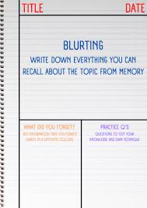
6. Memory games
Passive techniques which students find boring and often think is how you revise are reading and highlighting lots of text. They don’t help things stick in your mind very easily.
Active techniques move knowledge from your short term memory to your long term memory. Flashcards are a good example that you have read about so far.
Blurting is one technique where:
Read or watch a video.
Write down as much as you can remember.
In a different colour, rewatch the video or re-read the text and add missing information.
By using the second colour, you can visually see what you don’t remember.

Slide 8
7. Chunking
Chunking is a great way at helping our brain remember bits of information. Like a phone number, you are likely to remember 3 numbers at a time rather than the entire number.
Chunking is taking larger chunks of information into smaller ones so it’s easier to remember.
Examples like grouping people or events like characters from a novel, or group words into categories like French words on sport, school etc.
Look for connections between bits of information, and write these out which chunks the information better for you to remember!
Mnemonics are a good way of chunking information too, for instance from lowest to highest frequency we have radio waves, microwaves, infrared light, visible light, ultraviolet light, x-rays, and gamma rays. The mnemonic is: Raging Martians Invaded Venus Using X-ray Guns.

Slide 9
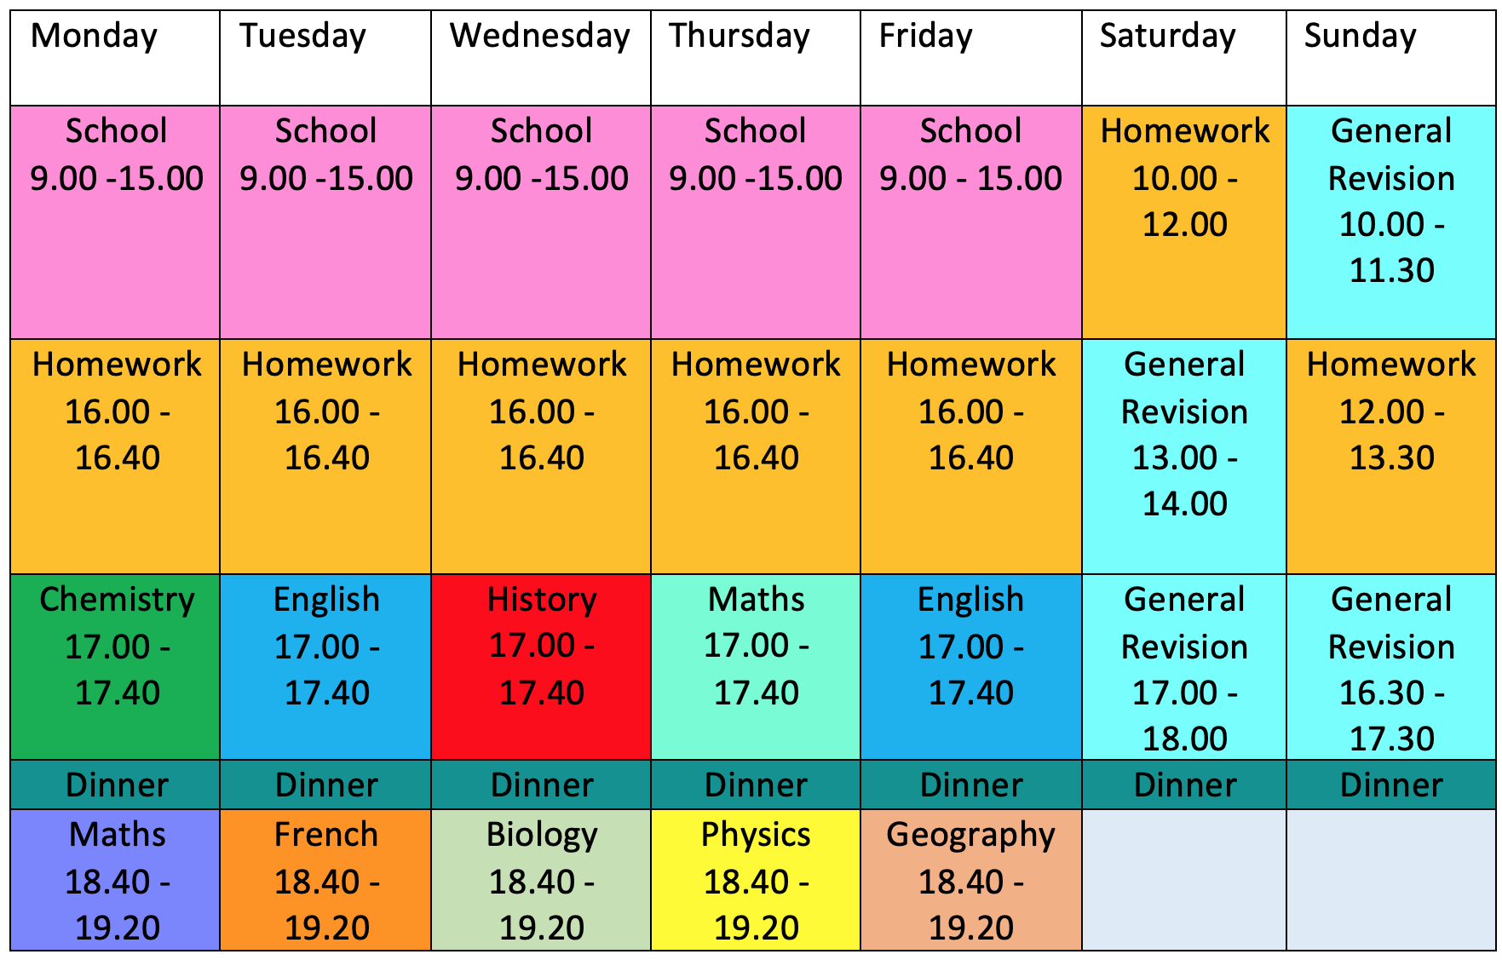
BUT I don’t even know where to start???????? ☹ HELP
Do the following:
Use a template like this one.
Add in all your school time, clubs, when you eat.
Fill in the rest of the gaps with your subjects of focus, equally. Be strict with this.
Discipline yourself, stick to it and remember to have breaks.
Have dedicated “down-time” where you will see friends, relax ad get fresh air.
If you feel it is impossible… speak to your form tutor. They will sit and help you plan how to fit it into your individual schedule.
If you try it for 2 weeks and feel like it is unmanageable, change it! Try again and see if it works better. You could reduce the time dedicated to each subject or be available for another.

